Slide 1


Speaker: Rishi S.
Design
Patterns

Slide 2

Objectives
After this module you will be able to:
Learn about Java Design Patterns
Identify and Explain Types of Java Design Patterns
Understand Benefits of Using Java Design Patterns
Recognize Real-World Examples of Java Design Patterns
Access Resources for Further Learning on Java Design Patterns

Slide 3

Introduction
Creational Patterns
Structural Patterns
Behavioral Patterns

Slide 4

Introduction
What are Design Patterns?
Design patterns are typical solutions to common problems in software design. Each pattern is like a blueprint that we can customize to solve a particular design problem in our code.
Design patterns differ by their complexity, level of detail and scale of applicability. In addition, they can be categorized by their intent and divided into three groups.
Design Patterns

Slide 5
Introduction
Three Groups of Design Patterns
Creational Patterns provide object creation mechanisms that increase flexibility and reuse of existing code.
Structural Patterns explain how to assemble objects and classes into larger structures, while keeping these structures flexible and efficient.
Behavioral Patterns take care of effective communication and the assignment of responsibilities between objects.
Design Patterns

Slide 6
Introduction
Creational Patterns
Structural Patterns
Behavioral Patterns

Slide 7
Creational Patterns
What are Creational Patterns?
Creational Patterns deal with the process of creation of objects of classes.
Design Patterns

Slide 8
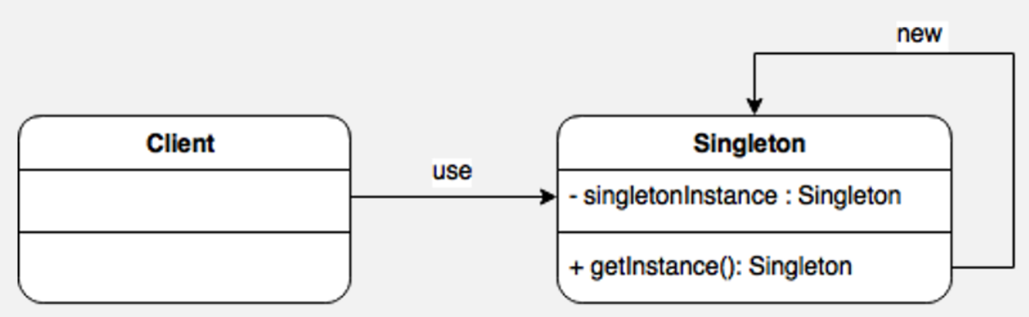
Creational Patterns
Singletons
Ensures a class has only one instance
Provides a global access point to that instance
Java’s implementation makes use of a private constructor, a static method combined with a static variable.
Design Patterns

Slide 9
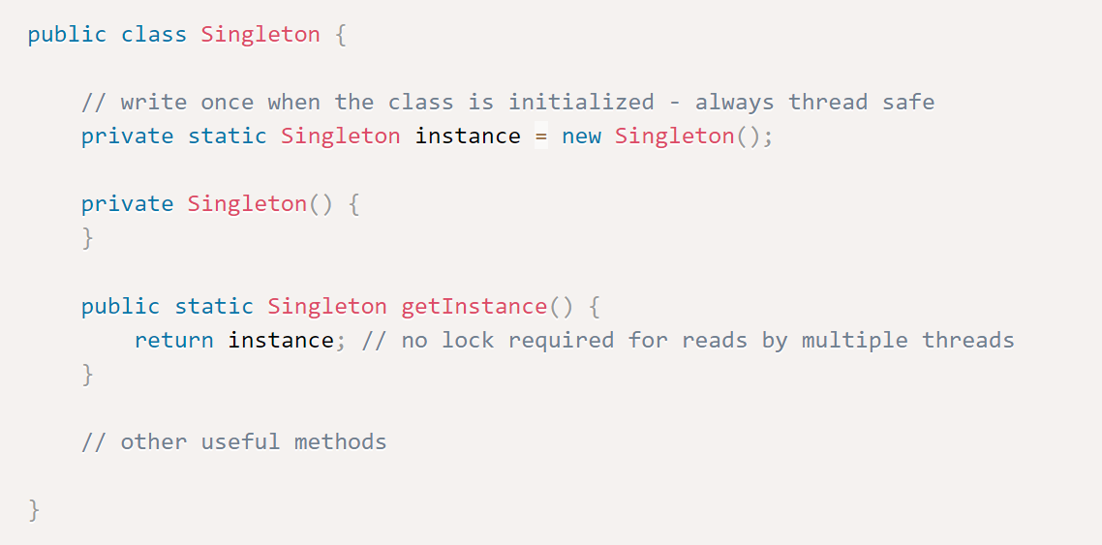
Creational Patterns
Singleton
There is one caveat: a privileged client can invoke the private constructor reflectively with the aid of the AccessibleObject.setAccessible() method.
If we need to defend against this attack, we can modify the constructor to make it throw an exception if it’s asked to create a second instance.
Design Patterns

Slide 10
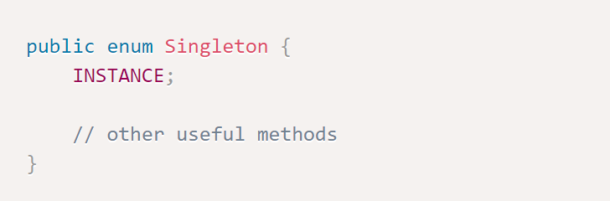
Creational Patterns
Singletons
The MOST correct, clean and concise implementation of Singleton design pattern is to use ENUM.
Design Patterns

Slide 11
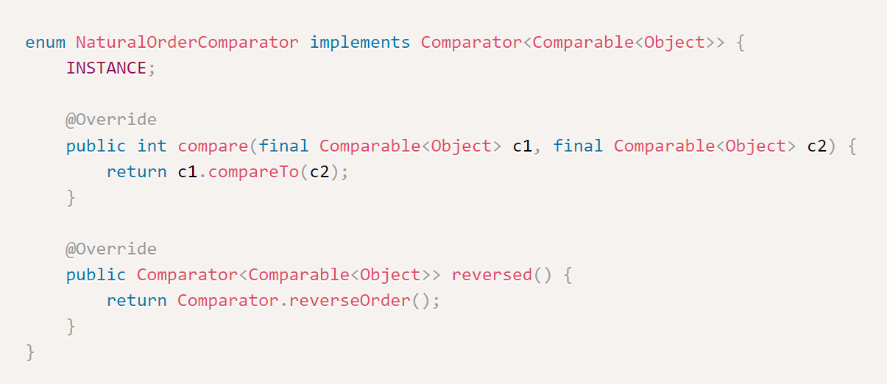
Creational Patterns
Singletons
The same way it is used all over JDK APIs, for ex:
Design Patterns

Slide 12
Creational Patterns
Builder
Used to encapsulate the construction of a product and allow it to be constructed in steps.
Instead of making the desired object directly, the client calls a constructor (or static factory) with all the required parameters and gets a builder object.
Then the client calls setter-like methods on the builder object to set each optional parameter of interest.
Finally, the client calls a parameterless build method to generate the object, which is typically immutable.
The builder is typically a static member class of the class it builds.
Design Patterns

Slide 13
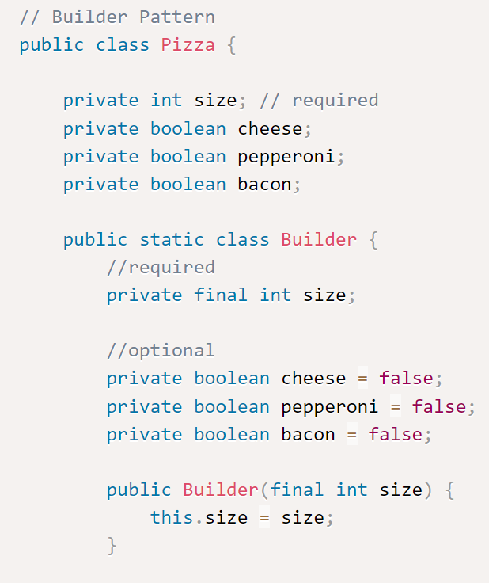
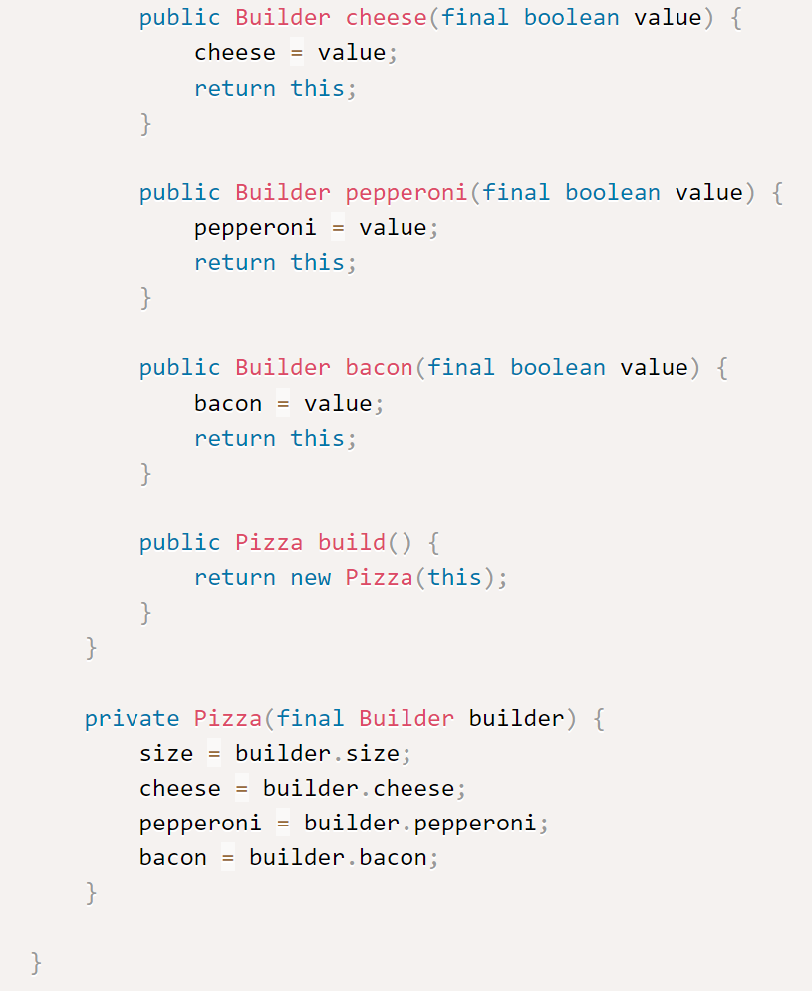
Creational Patterns
Design Patterns

Slide 14
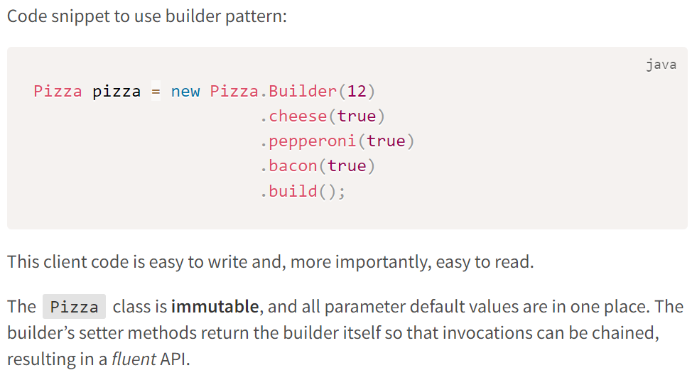
Creational Patterns
Builder
Design Patterns

Slide 15
Creational Patterns
Simple Factory
The Simple Factory lets us create objects without exposing the instantiation logic to the client and refer to the newly created object using a common interface.
It is not considered a standard Gang of Four design pattern, but it is often used as a stepping stone to understanding the Factory Method and the Abstract Factory.
Suppose that we’re working for a bank that needs a way of creating different financial products: loans, bonds, stocks, and so on.
Design Patterns

Slide 16
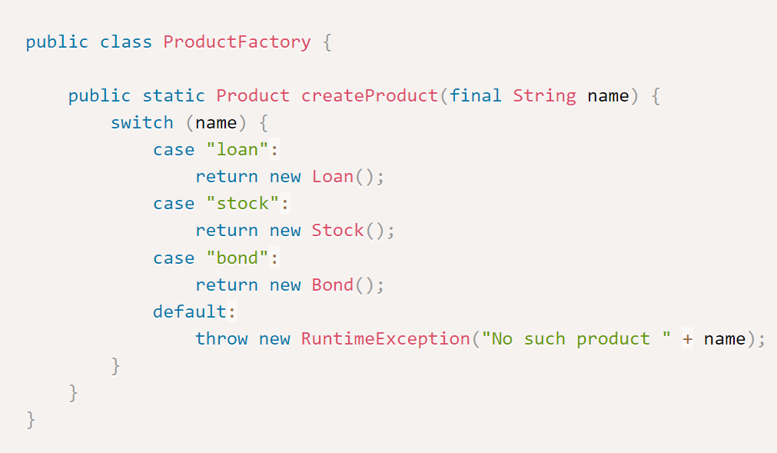
Creational Patterns
Simple Factory
Typically, we’d create a Factory class with a method that’s responsible for the creation of different objects, as shown here:
Design Patterns

Slide 17
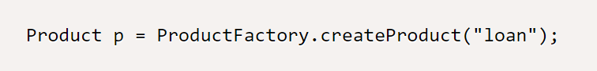
Creational Patterns
Simple Factory
Here, Loan, Stock, and Bond are subtypes of Product. The createProduct() method could have additional logic to configure each created product.
But the benefit is that we can create these objects without exposing the constructor and the configuration to the client, which makes the creation of products simpler for the client, as follows:
Design Patterns

Slide 18
Introduction
Creational Patterns
Structural Patterns
Behavioral Patterns

Slide 19
Structural Patterns
What are Structural Patterns?
The Structural Patterns explain how to assemble objects and classes into larger structures, while keeping these structures flexible and efficient, e.g.
Adapter
Decorator
Design Patterns

Slide 20
Structural Patterns
Decorator
A Decorator pattern can be used to attach additional responsibilities to an object either statically or dynamically. Decorators provide a flexible alternative to sub-classing for extending functionality.
In the implementation of this pattern, we prefer composition over an inheritance – so that we can reduce the overhead of subclassing again and again for each decorating element.
Design Patterns

Slide 21
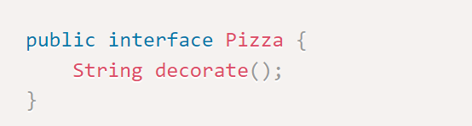
Structural Patterns
Decorator
Suppose we have a Pizza object, and we want to decorate it. The decoration does not change the object itself; it’s just that in addition to the Pizza, we’re adding some decoration items like cheese, pepperoni, bacon, etc.
Design Patterns

Slide 22
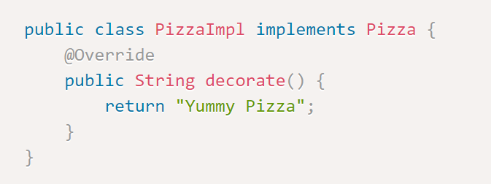
Structural Patterns
Decorator
The implementation of this interface will look like:
Design Patterns

Slide 23
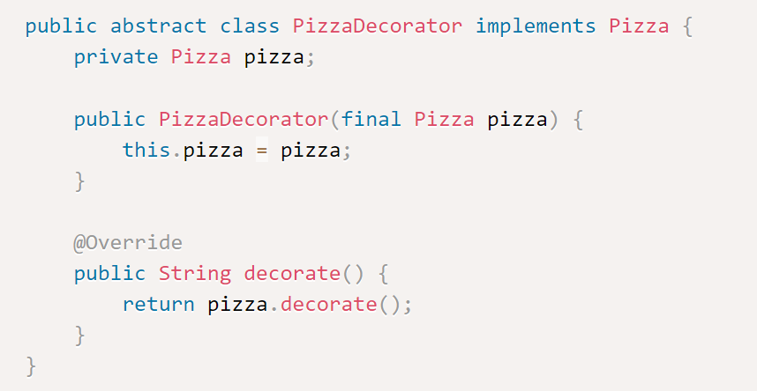
Structural Patterns
Decorator
We’ll now create an abstract PizzaDecorator class for this pizza. This decorator will implement the Pizza interface as well as hold the same object.
The implemented method from the same interface will simply call the decorate() method from our interface:
Design Patterns

Slide 24
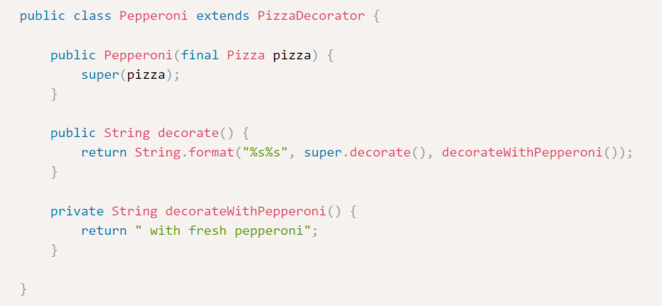
Structural Patterns
Decorator
We’ll now create some decorating element. These decorators will extend our abstract PizzaDecorator class and will modify its decorate() method according to our requirement:
Design Patterns

Slide 25
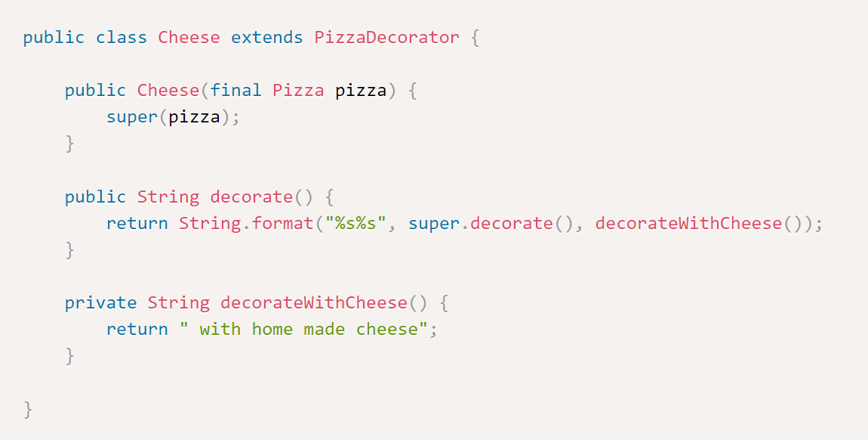
Structural Patterns
Decorator
Similarly, we can create decorators for cheese and bacon.
Design Patterns

Slide 26
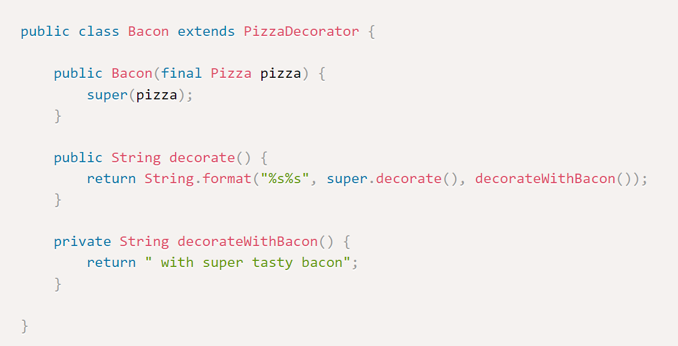
Structural Patterns
Decorator
Design Patterns

Slide 27
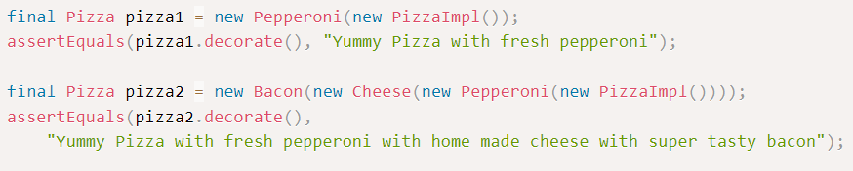
Structural Patterns
Decorator
Here is the main code to show decorator pattern.
Design Patterns

Slide 28
Structural Patterns
Adapter
An Adapter pattern acts as a connector between two incompatible interfaces that otherwise cannot be connected directly.
The main goal for this pattern is to convert an existing interface into another one the client expects.
Enumeration and Iterator are two related interfaces that are great examples of adapter-adaptee relationships.
Design Patterns

Slide 29
Structural Patterns
Adapter
Iterator differ from Enumeration in two ways:
Iterators allow the caller to remove elements from the underlying collection during the iteration.
Method names have been improved.
Design Patterns

Slide 30
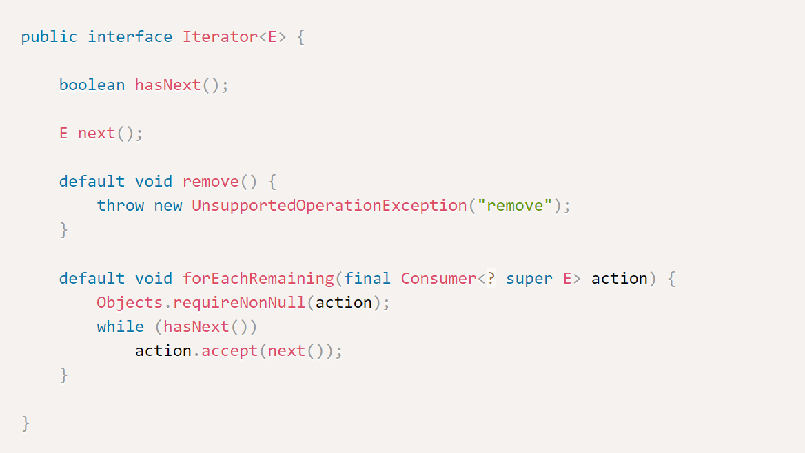
Structural Patterns
Adapter - Iterator Example
Design Patterns

Slide 31
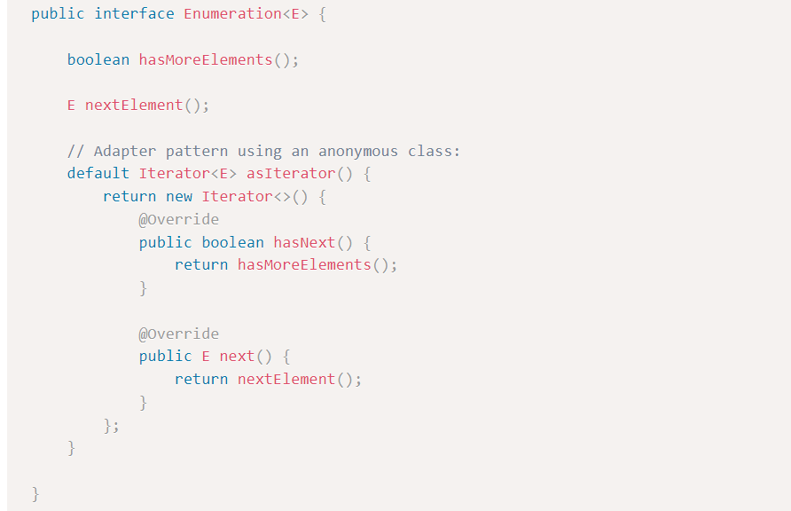
Structural Patterns
Adapter - Enumeration Example
Design Patterns

Slide 32
Introduction
Creational Patterns
Structural Patterns
Behavioral Patterns

Slide 33
Behavioral Patterns
What are Behavioral Patterns?
Behavioral design patterns are concerned with algorithms and the assignment of responsibilities between objects.
Design Patterns

Slide 34
Behavioral Patterns
Strategy
The strategy pattern is a common solution for representing a family of algorithms and letting us choose among them at runtime.
We can apply this pattern to a multitude of scenarios, such as validating an input with different criteria, using different ways of parsing, or formatting an input.
Design Patterns

Slide 35
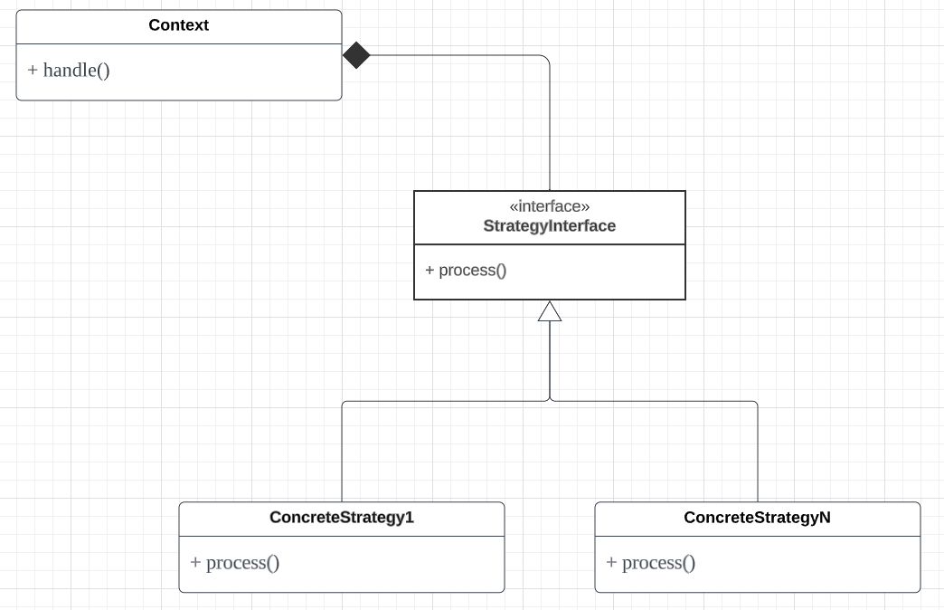
Behavioral Patterns
Strategy
An interface to represent some algorithm (the StrategyInterface)
One or more concrete implementations of that interface to represent multiple algorithms (the concrete classes ConcreteStrategyA, ConcreteStrategyB)
One or more clients that use the strategy objects (Context)
Design Patterns

Slide 36
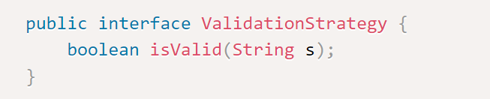
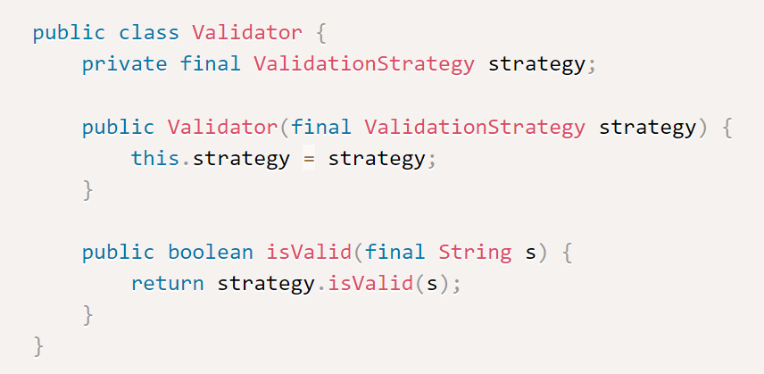
Behavioral Patterns
Strategy
Suppose we have to validate some strings.
Design Patterns

Slide 37
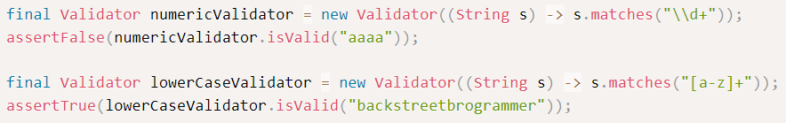
Behavioral Patterns
Strategy
We can use different validation strategies in our program.
Design Patterns

Slide 38
Behavioral Patterns
Observer
Defines a one-to-many dependency between objects so that when one object changes state, all of its dependents are notified and updated automatically.
Observers are loosely coupled in that the Observable knows nothing about them, other than that they implement the Observer interface.
Design Patterns

Slide 39
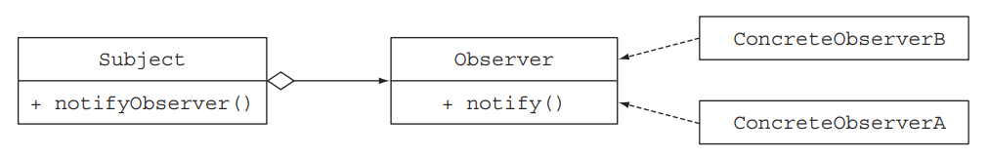
Behavioral Patterns
Observer
The observer design pattern is a common solution when an object (called the subject) needs to automatically notify a list of other objects (called observers) when some event happens (such as a state change).
Design Patterns

Slide 40
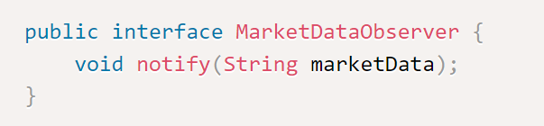
Behavioral Patterns
Observer
MarketDataObserver has one method, called notify(), that will be called by the subject (MarketDataFeed) when a new market data tick is available:
Design Patterns

Slide 41
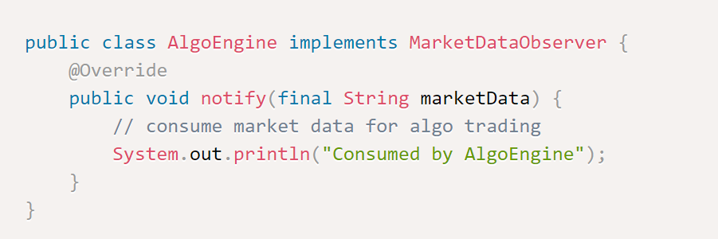
Behavioral Patterns
Observer
Various observers classes:
Design Patterns

Slide 42
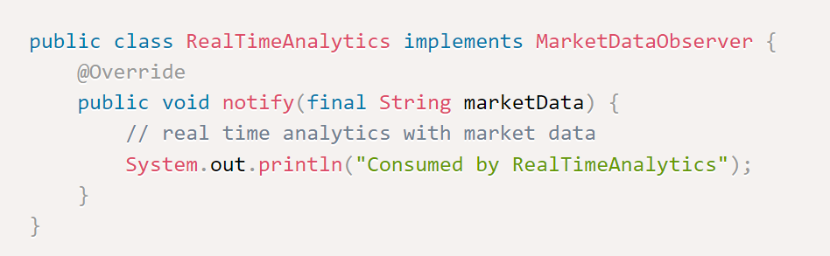
Behavioral Patterns
Observer
Various observers classes:
Design Patterns

Slide 43
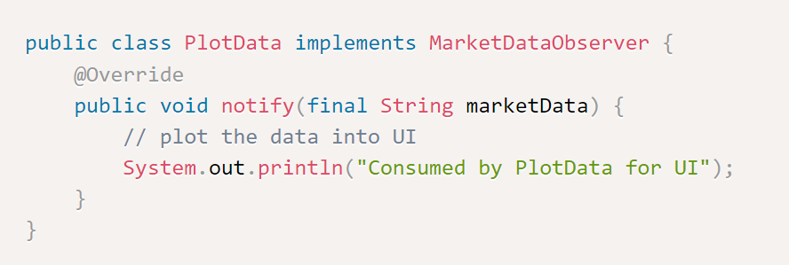
Behavioral Patterns
Observer
Various observers classes:
Design Patterns

Slide 44
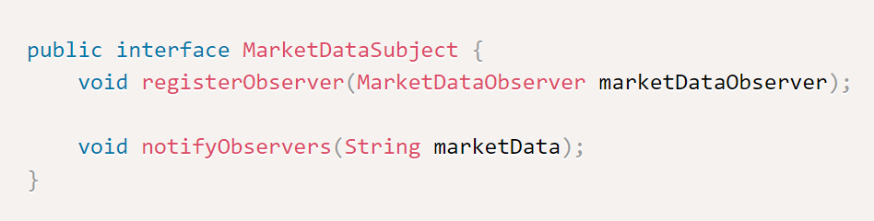
Behavioral Patterns
Observer
Now we define subject for registering and notifying observers.
Design Patterns

Slide 45
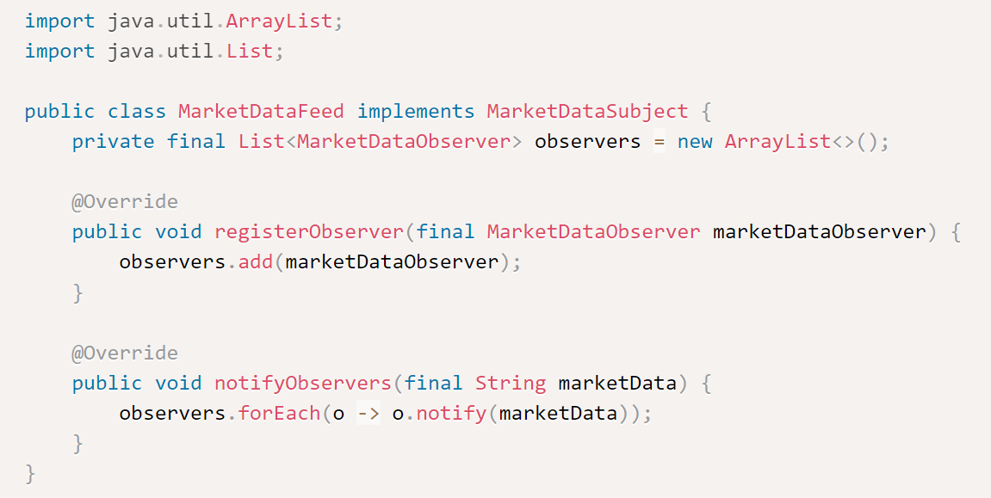
Behavioral Patterns
Observer
This is the MarketDataFeed class which implements the subject.
Design Patterns

Slide 46
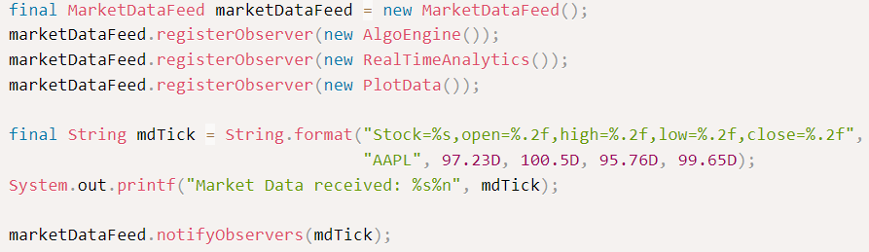
Behavioral Patterns
Observer
In the main code or client code, this observer pattern is used whenever a new market data tick is received and all the observers are notified.
Design Patterns

Slide 47
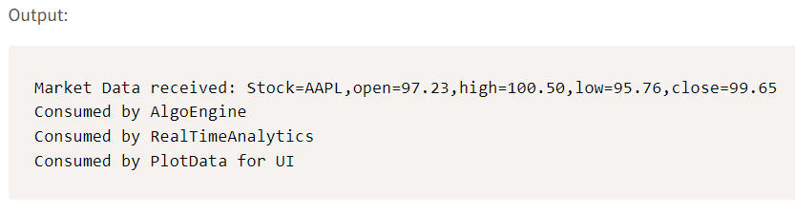
Behavioral Patterns
Observer
Design Patterns

Slide 48
Behavioral Patterns
Template
Defines the skeleton of an algorithm in a method, deferring some steps to subclasses.
Template Method lets subclasses redefine certain steps of an algorithm without changing the algorithm’s structure.
In other words, the template method pattern is useful when we find ourselves saying “I’d love to use this algorithm, but I need to change a few lines, so it does what I want.”
Design Patterns

Slide 49
Behavioral Patterns
Template Example (asked in Société Générale interview)
Suppose that we need to write a simple online banking application.
Users typically enter a customer ID; the application fetches the customer’s details from the bank’s database and does something to make the customer happy.
Design Patterns

Slide 50
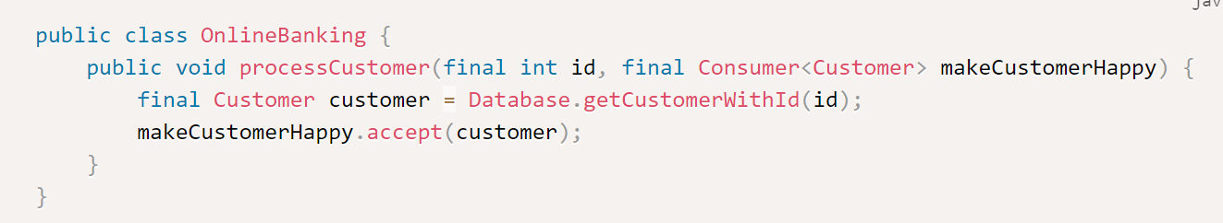
Behavioral Patterns
Template Example (asked in Société Générale interview)
Different online banking applications for different banking branches may have different ways of making a customer happy (such as adding a bonus to her account or sending her less paperwork).
Design Patterns

Slide 51
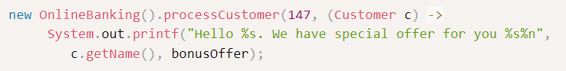
Behavioral Patterns
Template Example (asked in Société Générale interview)
Now we can plug in different behaviors directly without subclassing the OnlineBanking class by passing lambda expressions:
Design Patterns

Slide 52
Behavioral Patterns
Chain of Responsibility
The chain of responsibility pattern is a common solution to create a chain of processing objects (such as a chain of operations).
One processing object may do some work and pass the result to another object, which also does some work and passes it on to yet another processing object, and so on.
Used when you want to give more than one object a chance to handle a request.
Each object in the chain acts as a handler and has a successor object. If it can handle the request, it does; otherwise, it forwards the request to its successor.
Design Patterns

Slide 53
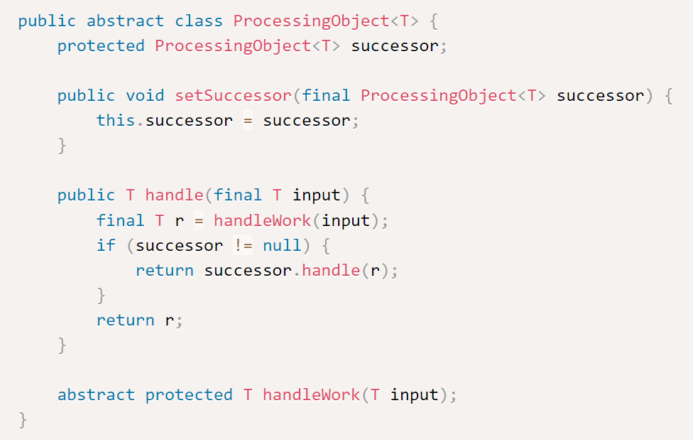
Behavioral Patterns
Chain of Responsibility
Design Patterns

Slide 54
Behavioral Patterns
Chain of Responsibility
The abstract class ProcessingObject represents a processing object that defines a field to keep track of a successor. When it finishes its work, the processing object hands over its work to its successor.
We can create different kinds of processing objects by subclassing the ProcessingObject class and by providing an implementation for the handleWork() method.
Design Patterns

Slide 55
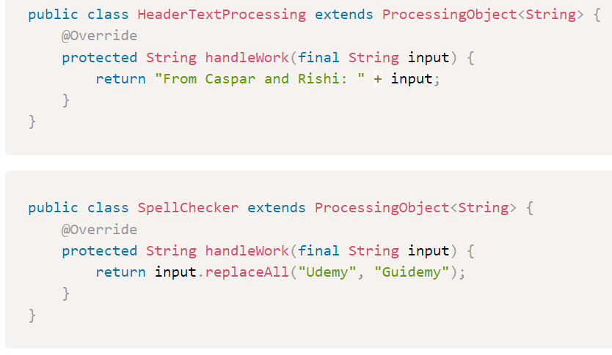
Behavioral Patterns
Chain of Responsibility
Design Patterns

Slide 56
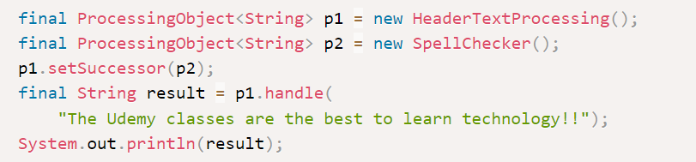
Behavioral Patterns
Chain of Responsibility
To use in the client code, here is a sample:
Output:
Design Patterns

Slide 57
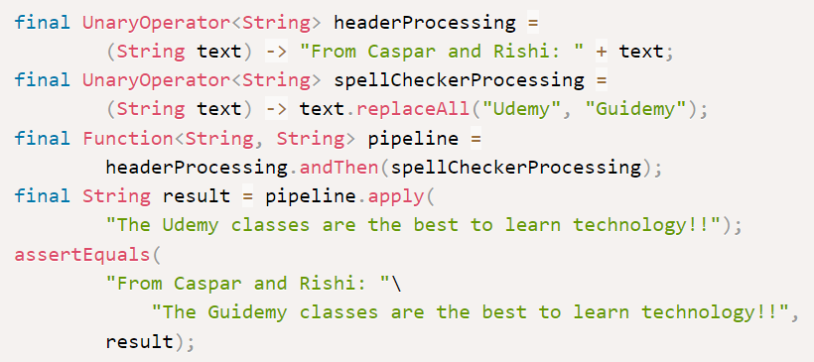
Behavioral Patterns
Chain of Responsibility
We can do the same thing using lambdas as shown below:
Design Patterns

Slide 58

Summary
Introduction: Overview of what design patterns are, their importance in creating scalable and maintainable software, and an introduction to the different types of design patterns: Creational, Structural, and Behavioral.
Creational Patterns: Discusses patterns that deal with object creation mechanisms, aiming to create objects in a manner best suited to the situation.
Singleton: Describes the Singleton pattern which ensures that only a single instance of a class exists and provides a global point of access to it.
Builder: Explores the Builder pattern which allows the creation of complex objects step-by-step, and provides an API for doing the same.
Simple Factory: Encapsulates the instantiation of objects, delegating this responsibility to a separate factory, for improved modularity and readability.

Slide 59
Summary
Structural Patterns: Discusses patterns that help ensure the pieces of a system fit together to form a whole, making the system easy to understand, maintain, and expand.
Decorator: Reviews the Decorator pattern which allows behavior to be added to an individual object, either statically or dynamically, without affecting the behavior of other objects from the same class.
Adapter: Explores the Adapter pattern which allows objects with incompatible interfaces to work together by wrapping its own interface around that of an already existing class.
Behavioral Patterns: Discusses patterns that are specifically concerned with communication between objects.
Strategy: Explains the Strategy pattern which allows selecting an algorithm at runtime.
Observer: Describes the Observer pattern which defines a subscription mechanism to notify multiple objects about any events that happen to the object they’re observing.
Template: Reviews the Template pattern which defines the program skeleton of an algorithm in a method, deferring some steps to subclasses.
Chain of Responsibility: Discusses the Chain of Responsibility pattern which lets you pass requests along a chain of handlers, allowing more than one object to have a chance at handling the request.

